Slide 1
Presented By: SaNJAY TAMRAKAR
TRENDS OF COMMODITIES/INDEX DURING 2000-2016

Slide 2




COMMODITIES AND INDEX

Slide 3
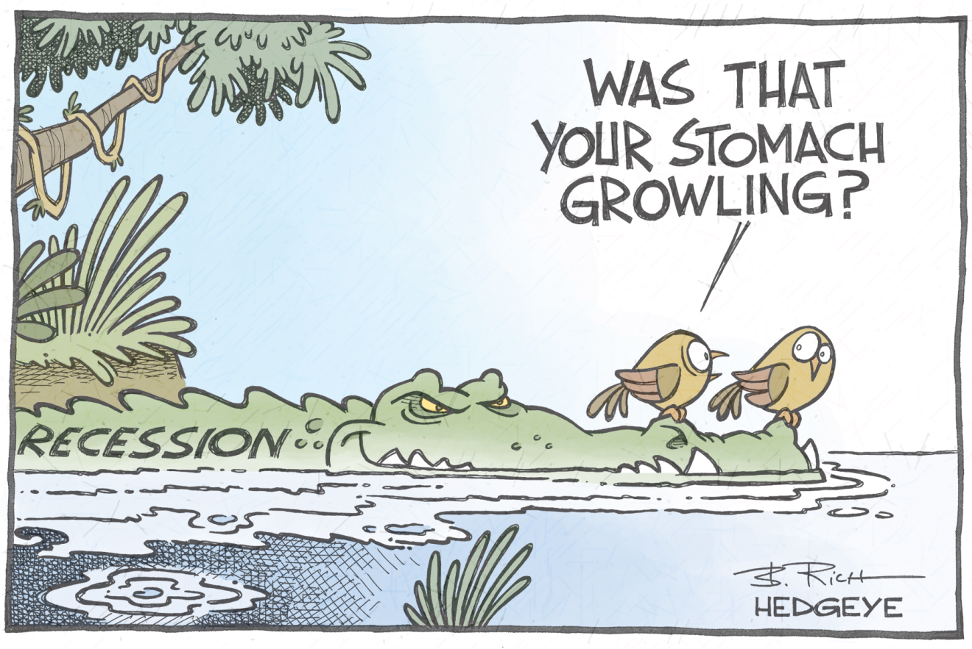
RECESSION In United states
Great Recession (Dec 2007,Jun 2009)
Unemployment (10%)
GDP decline (-5.1%)
Lasted 1 year and 6 months

Slide 4

How to know when you’re in a recession?
a decline in real GDP for two consecutive quarters
economy is in an official recession after six months of falling national income
higher unemployment
decline in confidence
falling house prices
decline in investment
lower inflation

Slide 5

Trends and Comparison
SHINY-APP

